Slide 1
CHAPTER III: RECORDING, POSTING BUSINESS TRANSACTION, BALANCING ACCOUNTS AND PREPARING TRIAL BALANCE.

Slide 2
3.1.DEFINITION OF JOURNAL AND JOURNALIZING
So far in the previous chapter we discussed the ledger accounts and movements. Each ledger account shows only the increases and decreases in that account.
Thus, all the effects of a single business transaction would not appear in any one account. For example, the cash account contains only data on changes in cash. It does not show how the cash was generated or what it was spent on. In order to have a permanent record of an entire transaction, the accountant uses the book or record known as a journal.

Slide 3
A journal is a chronological (arranged in order of time) record of business transactions. A journal entry shows all of the effects of a business transaction as expressed in terms of debit and credit and may include an explanation of the transaction. Notice that a transaction is entered in a journal before it is entered in ledger accounts. Because each transaction is initially recorded in a journal rather than directly in the ledger, a journal is called the book of original entry.
Although transactions could be entered directly to the accounts in the ledger, it is more convenient in a manual system to record them first in a journal; then when convenient, the debit and credit amounts can be transferred to the proper ledger accounts.
In addition to providing a complete record of every transaction, the journal is a useful device for reducing and locating errors.

Slide 4
Name of the Business
Date
A format of General Journal

Slide 5
3.2. JOURNAL’S ENTRY
THE SIMPLE JOURNAL ENTRY
An entry with one debit and one credit is a simple journal entry.
Example:
A COMPOUND JOURNAL ENTRY
Many business transactions affect more than two accounts. The journal entry for these transactions will involve more than one debit and or credit; such an entry is called a compound entry.
3.3. THE FUNCTIONS AND ADVANTAGES OF USING A JOURNAL
1. records each transaction in chronological order
2. shows the analysis of each transaction in terms of debit and credit
3. supplies an explanation of each transaction when necessary
4. serves as a source for future reference to accounting transactions
5. removes lengthy explanations from the accounts
6. makes possible posting to the ledger at convenient times
7. assists in maintaining the ledger in balance
8. helps in tracing errors.

Slide 6
3.4. ILLUSTRATION OF JOURNALIZING AND POSTING BUSINESS TRANSACTIONS
1. Ineza Aria invests frw 30,000,000 of her own money to start the business. She deposits frw 30,000,000 in a bank account titled Ineza Aria design and travel.
2. Ineza Aria purchases land for an office location, paying cheque of frw 20,000,000.
3. Ineza Aria buys stationery and other office supplies, agreeing to pay frw 300,000 within 30 days.
4. Ineza Aria earns revenue by providing travel services for clients. She earns frw 5,500,000 revenue and collects this amount in cash.
5. Ineza Aria performs service for clients who do not pay immediately. Ineza receives the clients’ promises to pay frw 3,000,000 within one month.
6. During the month, Ineza Aria pays frw 3,300,000 in cash expenses: rent expense machine frw 600,000; office rent frw 1,100,000; employee salary frw 1,200,000; and utilities frw 400,000
7. Ineza Aria pays frw 300,000 to the store from which she purchased supplies in transaction 3. In accounting, we say that she pays frw 300,000 on account.
8. In illustration 5, Ineza Aria performed services for a client on account. The business now collects frw 1,000,000 from the client.
9. Ineza Aria sells a part of land owned by the travel agency. The sale price of frw 9,000,000 is equal to purchasing price
10. Ineza Aria withdraws frw 2,000,000 cash from the business for personal use.

Slide 7
Ineza Aria design and travel General Journal as on 31/12/2023

Slide 8
3.5. LET POST or classify THESE BUSINESS TRANSACTIONS FROM GENERAL JOURNAL TO the ledgers using Account without balance column.

Slide 9
Posting in accounting refers to moving a transaction entry from a journal to a general ledger, which contains all of a company's financial accounts.
A journal's entries are chronological while a ledger compiles its transactions by accounts, such as assets or liabilities.
Accountants use general ledgers to create financial statements or records. To do this, the accountant needs to keep accurate reports of the company's monetary transactions so they can create an organized general ledger.

Slide 10
Aria design and travel
31.12.20xx
Accounts without balance column
101 Cash A/C
Debit |  |  |  |  | Credit
Date | Details | Folio | Amount |  | Date | Details | Folio | Amount
4 | Revenue |  | 5,500,000 |  | 6 | Machine rent |  | 600,000
8 | Account receivable |  | 1,000,000 |  |  | House Rent |  | 1,100,000
9 | Land |  | 9,000,000 |  |  | Salary |  | 1,200,000
 |  |  |  |  |  | Utilities |  | 400,000
 |  |  |  |  | 10 | Drawings |  | 2,000,000
 |  |  |  |  |  | Debit balance |  | 9,900,000

Slide 11
Aria design and travel
31.12.20xx
Accounts without balance column
.111 Bank A/C
Debit |  |  |  |  | Credit
Date | Details | Folio | Amount |  | Date | Details | Folio | Amount
1 | Capital |  | 30,000,000 |  | 2 | Land |  | 20,000,000
 |  |  |  |  |  | Debit balance |  | 10,000,000

Slide 12
121 Account Receivable
Debit |  |  |  |  | Credit
Date | Details | Folio | Amount |  | Date | Details | Folio | Amount
5 | Account receivable |  | 3,000,000 |  | 8 | Cash |  | 1,000,000
 |  |  |  |  |  | Dr. Bal |  | 2,000,000

Slide 13
131 Office supplies A/C
Debit |  |  |  |  | Credit
Date | Details | Folio | Amount |  | Date | Details | Folio | Amount
3 | Account payable |  | 300,000
 |  |  |  |  |  | Dr. Bal |  | 300,000
141 Land A/C
Debit |  |  |  |  | Credit
Date | Details | Folio | Amount |  | Date | Details | Folio | Amount
2 | Bank |  | 20,000,000 |  | 9 | Cash |  | 9,000,000
 |  |  |  |  |  | Debit balance |  | 11,000,000

Slide 14
301 Ineza Capital A/C
Debit |  |  |  |  | Credit
Date | Details | Folio | Amount |  | Date | Details | Folio | Amount
 |  |  |  |  | 1 | Bank |  | 30,000,000
 | Cr. Bal |  | 30,000,000

Slide 15
311 Ineza Drawings A/C
Debit |  |  |  |  | Credit
Date | Details | Folio | Amount |  | Date | Details | Folio | Amount
10 | Cash |  | 2,000,000
 |  |  |  |  |  | Debit balance |  | 2,000,000
401 Service Revenue A/C
Debit |  |  |  |  | Credit
Date | Details | Folio | Amount |  | Date | Details | Folio | Amount
 |  |  |  |  | 4 | Cash A/C |  | 5,500,000
 |  |  |  |  | 5 | Account receivable |  | 3,000,000
 | Credit balance |  | 8,500,000

Slide 16
501 Salary Expense A/C
Debit |  |  |  |  | Credit
Date | Details | Folio | Amount |  | Date | Details | Folio | Amount
6 | cash |  | 1,200,000
 |  |  |  |  |  | Debit balance |  | 1,200,000
502 Utilities Expenses A/C
Debit |  |  |  |  | Credit
Date | Details | Folio | Amount |  | Date | Details | Folio | Amount
6 | Cash |  | 400,000
 |  |  |  |  |  | Debit balance |  | 400,000

Slide 17
504 Machine rent Expense A/C
Debit |  |  |  |  | Credit
Date | Details | Folio | Amount |  | Date | Details | Folio | Amount
6 | Cash |  | 600,000
 |  |  |  |  |  | Dr. Bal |  | 600,000
505 Office rent expense A/C
Debit |  |  |  |  | Credit
Date | Details | Folio | Amount |  | Date | Details | Folio | Amount
6 | Cash |  | 1,100,000
 |  |  |  |  |  | Debit balance |  | 1,100,000

Slide 18
3.6. Next Step: Preparation of Trial Balance (EXTRACTION OF ACCOUNTS BALANCES)

Slide 19
A trial balance is a financial report that lists the closing balances of a business's general ledger accounts at a specific time. It's used to check that the accounting system is accurate and to identify errors before preparing financial statements.

Slide 20
In double-entry bookkeeping, each transaction is recorded with a debit and a credit entry. In the example, the sum of all debits and credits will balance out, ensuring account accuracy.
The purpose of a trial balance is to ensure that the total of all debit balances matches the total of all credit balances, highlighting the fundamental principle of double-entry bookkeeping.
This report plays a pivotal role in the accounting cycle, marking its final step before preparing financial statements. It acts as a tool for accountants and business owners to verify the accuracy of bookkeeping entries and to identify any potential errors that may have occurred during the accounting period.
A Trial Balance includes the accounts of Income Statement and the Balance Sheet financial statements.
Although a trial balance may equal the debits and credits, it does not mean the figures are correct. Errors can still occur in data entry of wrong amounts or posted to the incorrect account code.

Slide 21
From our example above let us prepare trial balance

Slide 22
Aria Design and travel 31/12/20xx Trial Balance
Note 1: In the trial balance above we do not have an important account of depreciation because the said company does not have assets to be depreciated. Land never get depreciated.
Note 2: The above trial balance is arranged in liquidity order.

Slide 23
3.7. ERRORS IN TRIAL BALANCE Errors in Trial Balance are mistakes made during the accounting process that cannot always be detected by the trial balance. These errors are classified under two heads: Errors disclosed by a trial balance Errors not disclosed by a trial balance

Slide 24
3.7.1. Types of Errors not disclosed by a Trial Balance:
The agreement of trial balance not always necessarily shows an accuracy check. There may be a number of errors that cannot be disclosed by the trial balance as the debit and credit side shows equal value. Such errors are known as limitations of Trial Balance.

Slide 25
Errors of Omission: Errors of Omission occur when a transaction is fully skipped. This means that the transaction has not been recorded either in the Journal or in Subsidiary Books. Under such a situation, the agreement of trial balance remains unaffected, as the transaction has neither been entered in the debit side nor the credit side of any account.
Example: Goods worth ₹8,000 sold to Mohan has not been recorded at all. This will not affect the agreement of the trial balance, as neither it has been recorded on the debit side of Mohan’s account nor on the credit side of the sales account.

Slide 26
Error of commission: Errors of Commission occur when a wrong amount has been recorded either in the Journal or in Subsidiary Books. The trial balance, despite such errors, still continues to tally because the same wrong amount has been recorded on both sides of the accounts.
Example: A cash purchase of ₹250 has been recorded in the Journal as ₹520. When this transaction is posted in the ledger account, the amount of ₹ 520 is entered as purchase being debited with ₹520 and cash being credited with ₹520. No error can be detected by the trial balance.

Slide 27
Errors of Principle: Errors of Principle occur when Accounting Principles are not applied or are violated while recording a transaction. These errors are of two types:
When capital expenditure is treated as revenue expenditure.
Example: Furniture worth ₹ 50,000 purchased is wrongly debited to the purchase account, instead of the Furniture account. Despite such Errors of Principle, the trial balance shows an agreement.
When a revenue expenditure is treated as capital expenditure.
Example: Amount of ₹2,000 spent on repair of old machinery being debited to machinery account, instead of repair account.

Slide 28
Compensating Errors: When the wrong amount posted in one account is compensated by the wrong posting of the same amount in another account is called Compensating Errors.
Example: Ram’s account is debited by ₹400, instead of ₹500 and Sham’s account is credited by ₹600, instead of ₹700. The trial balance doesn’t show any disagreement due to the shortage of ₹100 being recorded on both sides of the account.

Slide 29
3.7.2. Errors disclosed by a trial balance:
If the trial balance does not tally, it shows that the accountant has committed certain mistakes while recording the transactions. These are due to the lack of attention

Slide 30
Compensating error: Is committed when an error of the same magnitude, on either side of the ledger are committed in the books such that the errors counteract or cancel each other.
Error of complete reversal: This error is made when both the debit and credit entries of a transaction are completely reversed.
Error of duplication: When the same error is posted to the ledger twice along the correct principles of double entry system.

Slide 31
3.8. Correcting Errors
To correct errors in a trial balance, you need to first identify the source of the discrepancy by carefully reviewing the ledger accounts, comparing them to the trial balance, and checking for any posting errors, calculation mistakes, or missing entries; then, make necessary adjustments by creating correcting journal entries to rectify the incorrect amounts, ensuring the debit and credit columns of the trial balance.
If an error is discovered in the journal before the error is posted, it may be corrected by ruling a single line through the incorrect amount or account name and writing the right one above. However, if an amount is journalized and posted in a wrong account then a correcting entry must be prepared.

Slide 32
ASSIGNMENT 7
Which of the following errors will cause the trial balance totals to be unequal?
a. Amount incorrectly entered on the trial balance.
b. Failure to record a transaction or to post a transaction.
c. Recording the same transaction more than once.
d. Recording the same erroneous amount for both the debit and the credit parts of a transaction.
e. Posting a part of a transaction correctly as a debit or credit but to the wrong account.

Slide 33
3.8. From trial balance above let us prepare three first financial statements (income statement, owner’ s equity statement and balance sheet). The major purpose of this course at the end is to prepare financial statements. Now let us anticipate chapter 4 and 5 and we prepare them without requirement of adjustments since it is a new company which does not have opening trial balance and its related opening financial statements.

Slide 34
3.8.1. INCOME STATEMENT An income statement shows a business's revenue, expenses, gains, and losses, starting with revenue and ending with net income

Slide 35
Service companies have the most basic income statement of all the types of companies. Since service based companies do not sell a product, the income statement will not contain cost of goods sold. Therefore, the income statement will be a basic breakdown of income and expenses.
Begin with income. Then subtract all operating expenses. The difference between income and operating expenses is operating income. In this case, all expenses are period costs. There are no product costs associate with a service company.

Slide 36
Format of Service Companies’ s Income Statement

Slide 37
NOW IT IS A TIME OF APPLYING THE MATCHING PRINCIPLE.
It requires that expenses be reported on the income statement (statement of comprehensive income) in the same accounting period as are revenues that were earned as a result of the expenses.
In general terms, under accrual accounting, revenues are recognized when they are earned and expenses recognized (or matched against revenue) as assets are used.
Just as the realization principle has been developed by accountants to serve as a guide in the timing of revenue, the matching principle has been developed to guide the timing of expense recognition.
.

Slide 38
Aria Design and travel 31/12/20xx Income Statement
Note: Result is to be transferred in Owner’s Equity Statement

Slide 39
3.8.2. OWNER’ S EQUITY STATEMENT
An owner's equity statement is a financial document that shows how a business's equity has changed over a period of time. It's also known as a statement of changes in equity or a statement of shareholder's equity.

Slide 40
Statement of Owner’s Equity
The statement of owner’s equity shows the changes in capital for a business entity during a time period, such as a month, quarter, or year.
Capital increases when the business has
● owner contributions of capital, or
● a net income (revenues exceed expenses).
Capital decreases when the business has
● a net loss (expenses exceed revenues), or
● owner withdrawals of cash or other assets.

Slide 41
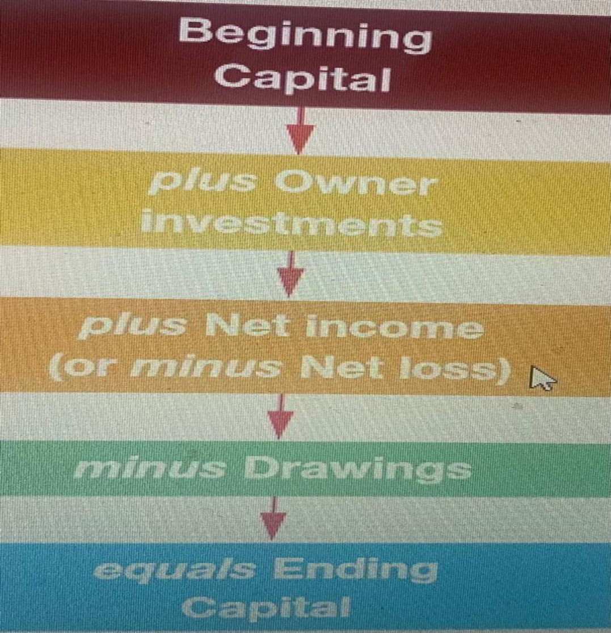
Ending Balance of Owners’ Equity
When preparing Owners’ Equity Statement; we use the formula here at the right side.

Slide 42
Aria Design and travel 31/12/20xx Owners Equity Statement
Initial Capital Balance 30,000,000
(+) New investment 0
(+)Net profit 3,640,000
(-)Drawings -2,000,000
Ending capital balance 31,640,000
Note: The result is to be transferred in Balance sheet or Statement of Financial Position.

Slide 43
3.8.3. A balance sheet oR statement of financial position A balance sheet is a financial statement that shows a company's assets, liabilities, and shareholder equity. It's one of the three main financial statements used to assess a business.
The balance sheet is one of the three fundamental financial statements and is key to both financial modeling and accounting. The balance sheet displays the company’s total assets and how the assets are financed, either through either debt or equity. It can also be referred to as a statement of net worth or a statement of financial position. The balance sheet is based on the fundamental equation: Assets = Liabilities + Equity.

Slide 44
Let us use order of permanence" or "reverse liquidity order; where assets are listed from the least liquid (long-term assets like property, plant, and equipment) to the most liquid (cash and cash equivalents) to present the Balance Sheet of Aria Design and travel
Other option is also called Liquidity or Eligibility Order.
On a balance sheet, the correct order of assets is from highest liquidity to lowest. Because cash assets convert easily, cash is first on the list. The least liquefied balance sheet assets are investments.

Slide 45
Name of business
Balance sheet
Date
ASSETS frw frw
Non current assets xxx
Land and buildings xxx
Plant and machinery xxx
Fixtures, furniture and fittings xxx
Motors vehicles xxx
Total non-current assets xxxx
Current Assets
Office Supplies xxx
Debtors/trade receivables xxx
Cash at bank xxx
Cash in hand xxx
Total current assets xxxx
Total Assets xxxxxxx

Slide 46
EQUITY AND LIABILITIES
CAPITAL XXX
NON CURRENT LIABILITIES
5 years loan xxx
2 years loan xxx
Total non current liabilities xxx
CURRENT LIABILITIES
Creditors/trade payables xxx
Current loans less than 1 year xxx
Bank overdraft xxx
Total current liabilities xxx
Total liabilities xxx
Total equity and liabilities xxxx

Slide 47
Aria Design and travel 31/12/20xx Balance Sheet
ASSETS |  |  |  | LIABILITIES AND OWNER’ S EQUITY
 | Amount | Amount |  |  | Amount | Amount
Fixed assets |  |  |  | Capital |  | 31,640,000
Land | 11,000,000 |  |  | Non-Current Liabilities/LTL | 0
Total Fixed Assets |  | 11,000,000 |  | Tax payable or Tax due | 1,560,000
Current assets |  |  |  | Total Non- Fixed liabilities/CL |  | 1,560,000
A/C Receivable | 2,000,000
Office supplies | 300,000
Bank | 10,000,000
Cash | 9,900,000
Total current assets |  | 22,200,000
Total assets |  | 33,200,000 |  | Total capital & liability |  | 33,200,000

Slide 48
Assignmenment no 8
From the above 11 transactions , you are required to record, classify, summarize and prepare 3 first Financial Statements.
1. The e-learning agency received $30,000 cash and gave capital to Sheena Bright.
2. Paid $20,000 cash for land.
3. Bought $500 of office supplies on account.
4. Received $5,500 cash from clients for service revenue earned.
5. Performed services for clients on account, $3,000.
6. Paid cash expenses: computer rent, $600; office rent, $1,100; employee salary, $1,200; utilities, $400.
7. Paid $300 on the account payable created in transaction 3.
8. Collected $1,000 on the account receivable created in transaction 5.
09. Sold land for cash at its cost of $9,000.
10. Owner withdrew cash of $2,000.

Slide 49
Assignmenment no 9
1. Jackie Fiona, CPA, completed these transactions during September of the current year:
a) Began a public accounting practice by investing Rwf4,200 in cash and office equipment having a Rwf4,800 fair value.
b) Prepaid two months’ rent in advance on sustainable office space, Rwf1,800.
c) Incurred advertising costs of Rwf140.
d) Purchased on credit office equipment, Rwf420, and office supplies, Rwf75.
e) Completed accounting work for a client and immediately received payment of Rwf180 cash.
f) Completed accounting work on credit for Fina Bank, Rwf700.
g) Paid the annual Rwf750 premium on an insurance policy.
h) Received payment in full from Fina Bank for the work completed in transaction (f)
i) Completed accounting work on credit for Travis Enterprise, Rwf500.
j) Jackie Fiona withdrew Rwf300 cash from the practice to pay personal expenses.
k) Purchased additional office supplies on credit, Rwf45.
l) Paid the September utility bills, Rwf165.
m) Paid the office secretary a salary of Rwf200 for the month of September.
Required:
i) Journalize entries for the business
ii) Post, Balance Accounts and make a Trial Balance.
iii) Prepare 3 first financial statements.

Slide 50
Assignmenment 10
Noreen opened a real estate business in the month of August during the current year, as an agent completed these business transactions.
a) Invested Rwf42,000 in cash and office equipment with a Rwf6,000 fair value in real estate agency she called Noreen Realty.
b) Purchased land valued at Rwf30,000 and a small office building valued at Rwf105,000 paying Rwf35,000 cash and signed a note payable for the balance.
c) Purchased office supplies on credit, Rwf60.
d) Noreen contributed her personal automobile to be used in the business; it had a fair value of Rwf7,200.
e) Purchased additional office equipment on credit, Rwf720.
f) Paid the office secretary’s salary, Rwf600.
g) Sold a house and collected an Rwf8,500 cash commission on the sale.
h) Paid Rwf150 for newspaper advertising.
i) Paid for supplies purchased on credit in transaction (c).
j) Purchased a typewriter for the business, paying Rwf840 cash and promised to pay the balance of Rwf140 later.
k) Completed real estate appraisal on credit and billed the client Rwf210 for the appraisal.
l) Paid the secretary’s salary, Rwf600.
m) Received payment in full for the appraisal of transaction (k).
n) Noreen withdrew Rwf1,500 from the business to pay personal expenses.
Required:
i) Journalize
ii) Post using T account, Balance the Accounts and Prepare a Trial balance as well as 3 first financial Statements.

